Slide 1
Lesson 4: Introduction to Proofs
Topics to be covered.
Methods of Proving Theorems
Direct Proof
Proof by Contraposition
Proofs by Contradiction
Proof by Cases
Existence Proofs
Proof Strategies

Slide 2
Proof of a Theorem
A proof is a valid argument that establishes the truth of a mathematical statement.
A proof can use axioms, statements assumed to be true, and previously proven theorems. Using these ingredients and rules of inference, the ﬁnal step of the proof establishes the truth of the statement being proved.
Note: Formal proofs of theorems can be extremely long and hard to follow. In practice, the proofs of theorems designed for human consumption are almost always informal proof.

Slide 3
Proofs
We can use a proof to demonstrate that a particular statement is true. A proof consists of a sequence of statements that form an argument.
The steps that connect the statements in such a sequence are the rules of inference.
Cases of incorrect reasoning are called fallacies.

Slide 4
Terminology
A Theorem is a statement that can be shown to be true.
A lemma is a simple theorem used as an intermediate result in the proof of another theorem.
A Corollary is a proposition that follows directly from a theorem that has been proved.
A Conjecture is a statement whose truth value is unknown. Once it is proven, it becomes a theorem.

Slide 5
Informal Proofs
In Mathematics, Computer Science, and other disciplines, informal proofs are generally used. Informal proofs are easy to understand and to explain to people.
In informal proofs:
More than one rule of inference may be used in a step.
Steps may be skipped.
The axioms being assumed and the rules of inference used are not explicitly stated.

Slide 6
Practical Applications of Proofs
Verifying that computer programs are correct
Establishing that operating systems are secure
Making inferences in artiﬁcial intelligence
Showing that system speciﬁcations are consistent.

Slide 7
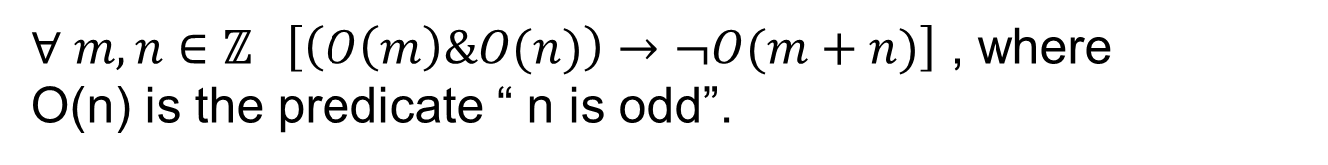
Understanding How Theorems Are Stated
Most of the theorems are conditional statement or quantified conditional statement.
Usual way of stating theorem (Example):
The sum of two odd integers is even
Formal way of stating theorem:
$∀ m,n∈ℤ \left(m,n \text{are} \text{odd} → m+n \text{is} \text{even} \right)$
$∀ m,n∈ℤ \left[\left(O\left(m\right)\&O(n)\right)→¬O(m+n)\right]$ , where
O(n) is the predicate “ n is odd”.

Slide 8
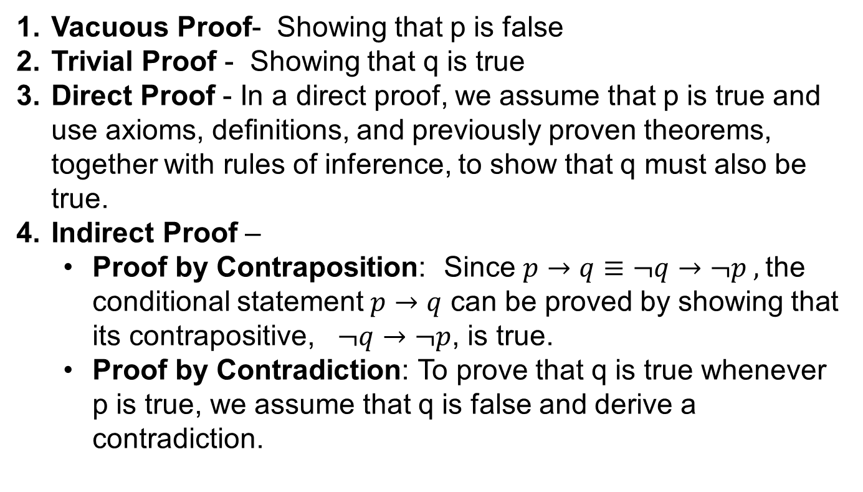
Methods of Proving Theorems of the form 𝒑→𝒒
Vacuous Proof- Showing that p is false
Trivial Proof - Showing that q is true
Direct Proof - In a direct proof, we assume that p is true and use axioms, deﬁnitions, and previously proven theorems, together with rules of inference, to show that q must also be true.
Indirect Proof –
Proof by Contraposition: Since $p→q≡¬q→¬p ,$the conditional statement $p→q$ can be proved by showing that its contrapositive, $¬q→¬p$, is true.
Proof by Contradiction: To prove that q is true whenever p is true, we assume that q is false and derive a contradiction.

Slide 9
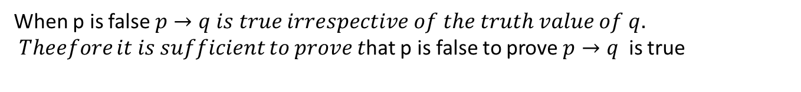
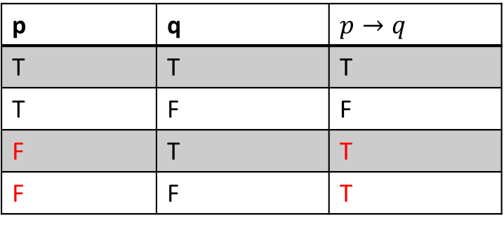
Vacuous Proof
p | q | $p→q$
T | T | T
T | F | F
F | T | T
F | F | T
When p is false $p→q is true irrespective of the truth value of q.$
𝑇ℎ𝑒𝑒𝑓𝑜𝑟𝑒 𝑖𝑡 𝑖𝑠 𝑠𝑢𝑓𝑓𝑖𝑐𝑖𝑒𝑛𝑡 𝑡𝑜 𝑝𝑟𝑜𝑣𝑒 𝑡hat p is false to prove $p→q$ is true

Slide 10
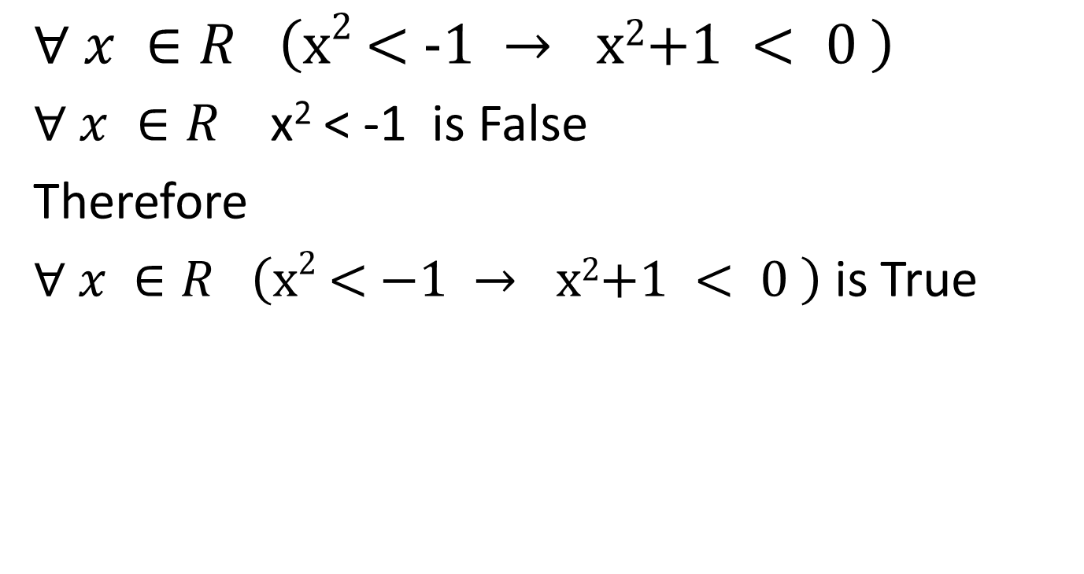
Vacuous Proof - Example
$$∀ x ∈R \left(\text{x}\text{2}\text{ < −1 }→ \text{x}\text{2}\text{+1 }< 0 \right)$$
$∀ x ∈R$ x² < -1 is False
Therefore
$∀ x ∈R \left(\text{x}\text{2}\text{ < −1 }→ \text{x}\text{2}\text{+1 }< 0 \right)$ is True

Slide 11
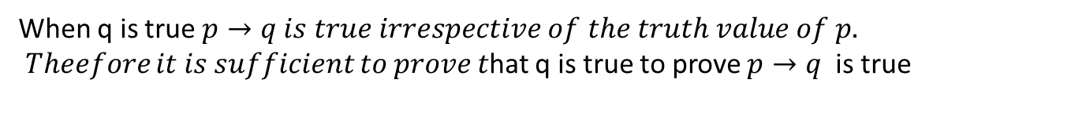
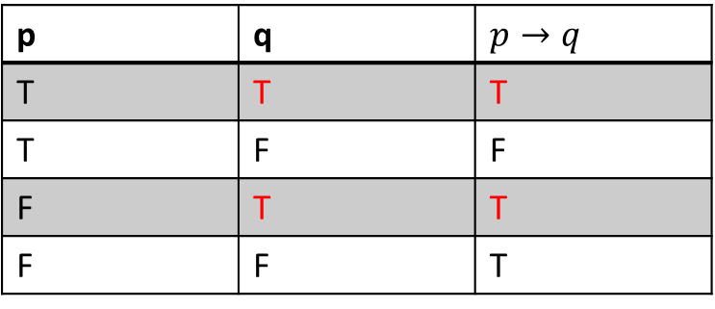
Trivial Proof - Examples
p | q | $p→q$
T | T | T
T | F | F
F | T | T
F | F | T
When q is true $p→q is true irrespective of the truth value of p.$
𝑇ℎ𝑒𝑒𝑓𝑜𝑟𝑒 𝑖𝑡 𝑖𝑠 𝑠𝑢𝑓𝑓𝑖𝑐𝑖𝑒𝑛𝑡 𝑡𝑜 𝑝𝑟𝑜𝑣𝑒 𝑡hat q is true to prove $p→q$ is true

Slide 12

Trivial Proof - Examples
$$∀ x ∈R \left(\text{x} ≥=0 → \text{x}\text{2}\text{+2}\text{x}\text{+1 }≥0 \right)$$
Proof :
$\text{x}\text{2}\text{+2}\text{x}\text{+1 = (}\text{x}\text{+1)2}$ >= 0 $∀ x ∈R$
Therefore
$$∀ x ∈R \left(\text{x} ≥=0 → \text{x}\text{2}\text{+2}\text{x}\text{+1 }≥0 \right)$$

Slide 13
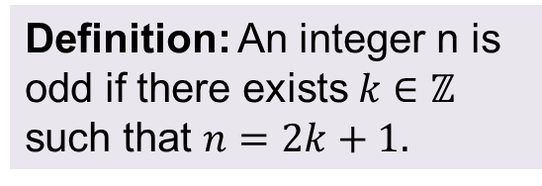
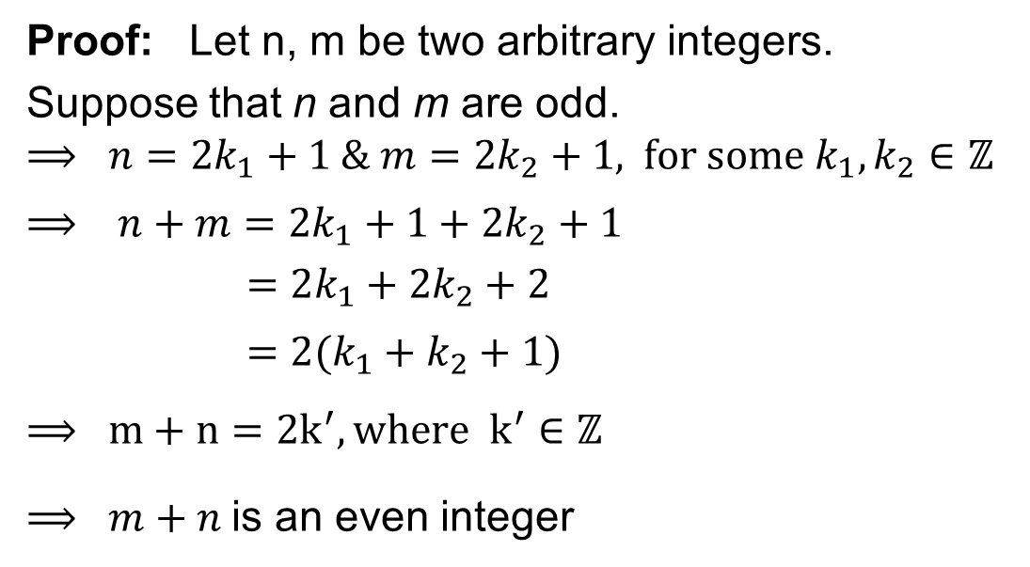
Direct Proofs: Example 1
Theorem: The sum of two odd integers is even.
Proof: Let n, m be two arbitrary integers.
Suppose that n and m are odd.
$$⟹ n=2k_{1}+1 \& m=2k_{2}+1\text{, }\text{for} \text{some} k_{1}, k_{2}∈ℤ$$
$$⟹ n+m=2k_{1}+1+2k_{2}+1$$
$$=2k_{1}+2k_{2}+2$$
$$=2(k_{1}+k_{2}+1)$$
$$⟹ m+n=2k^{′}, \text{where} k^{′}∈ℤ$$
$⟹ m+n$is an even integer
Definition: An integer n is odd if there exists $k∈ℤ$ such that $n=2k+1.$
Since n, m are arbitrary we have, the sum of any two odd integers is even.

Slide 14
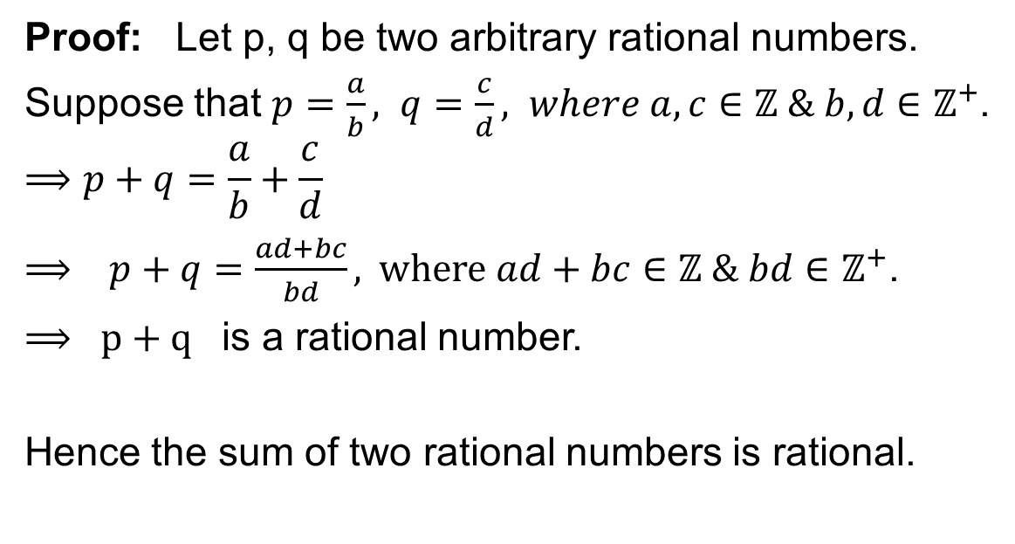
Direct Proofs: Example 1
Prove that the sum of two rational numbers is rational.
Proof: Let p, q be two arbitrary rational numbers.
Suppose that $p=\frac{a}{b}, q=\frac{c}{d}, where a,c∈ℤ \& b,d∈ℤ^{+}$.
$$⟹p+q=\frac{a}{b}+\frac{c}{d}$$
$⟹ p+q=\frac{ad+bc}{bd}\text{, }where ad+bc∈ℤ \& bd∈ℤ^{+}$.
$⟹ p+q$ is a rational number.
Hence the sum of two rational numbers is rational.

Slide 15
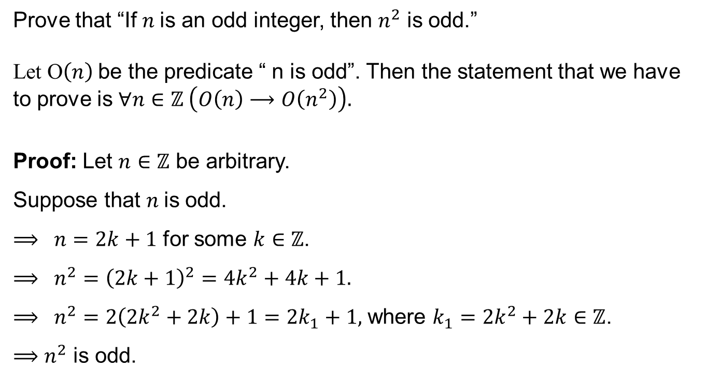
Direct Proofs: Example 3
Prove that “If $n$is an odd integer, then $n^{2}$ is odd.”
Let O$\left(n\right)$be the predicate “ n is odd”. Then the statement that we have to prove is $∀n∈ℤ \left(O\left(n\right)⟶O\left(n^{2}\right)\right).$
Proof: Let $n∈ℤ$ be arbitrary.
Suppose that $n$is odd.
$⟹ n=2k+1$ for some $k∈ℤ$.
$⟹ n^{2}={\left(2k+1\right)}^{2}=4k^{2}+4k+1.$
$⟹ n^{2}=2\left(2k^{2}+2k\right)+1=2k_{1}+1,$ where $k_{1}=2k^{2}+2k∈ℤ$.
$⟹$ $n^{2}$ is odd.

Slide 16
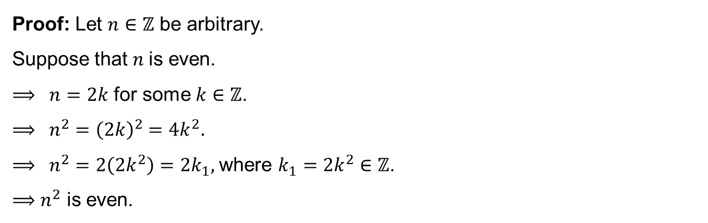
Indirect Proofs: Example 1 (Proof by contraposition)
Prove that for an integer n, if n² is odd, then n is odd.
Let O$\left(n\right)$be the predicate “ n is odd”. Then the statement that we have to prove is $∀n∈ℤ \left(O\left(n^{2}\right)⟶O\left(n\right)\right).$ That is equivalent to $∀n∈ℤ \left(¬ O\left(n\right)⟶¬ O\left(n^{2}\right)\right)$.
Proof: Let $n∈ℤ$ be arbitrary.
Suppose that $n$is even.
$⟹ n=2k$ for some $k∈ℤ$.
$⟹ n^{2}={\left(2k\right)}^{2}=4k^{2}.$
$⟹ n^{2}=2\left(2k^{2}\right)=2k_{1},$ where $k_{1}=2k^{2}∈ℤ$.
$⟹$ $n^{2}$ is even.

Slide 17
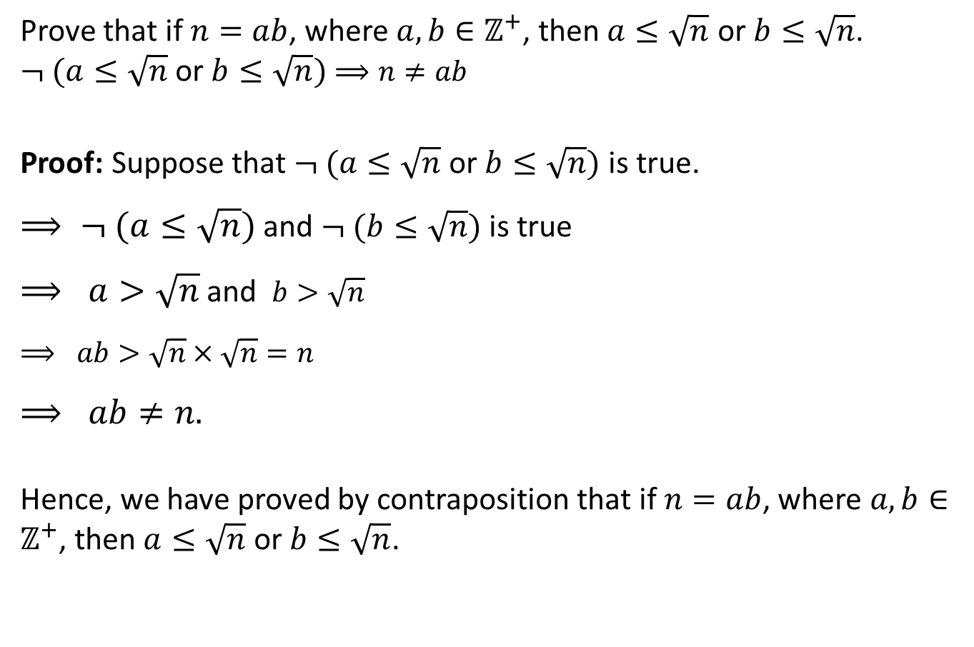
Proof by contraposition – Example-2
Prove that if $n=ab$, where $a,b∈ℤ^{+}$, then $a≤\sqrt{n}$ or $b≤\sqrt{n}$.
$¬ (a≤\sqrt{n} \text{or} b≤\sqrt{n})$ $⟹n≠ab$
Proof: Suppose that $¬ (a≤\sqrt{n} \text{or} b≤\sqrt{n})$ is true.
$⟹ ¬ (a≤\sqrt{n})$ and $¬ (b≤\sqrt{n})$ is true
$⟹ a>\sqrt{n}$ and $b>\sqrt{n}$
$⟹ ab>\sqrt{n}×\sqrt{n}=n$
$⟹ ab≠n.$
Hence, we have proved by contraposition that if $n=ab$, where $a,b∈ℤ^{+}$, then $a≤\sqrt{n}$ or $b≤\sqrt{n}$.

Slide 18
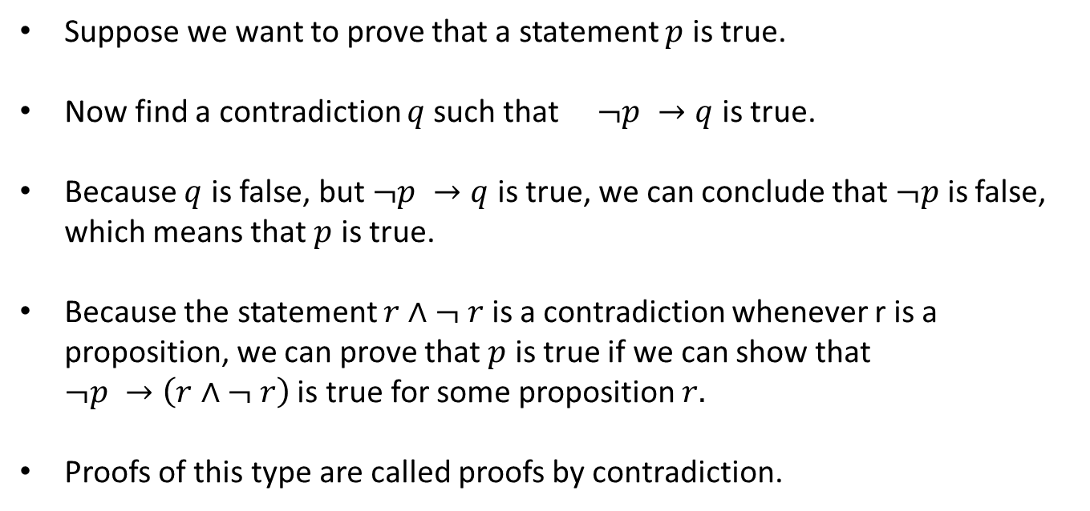
Proofs by Contradiction
Suppose we want to prove that a statement $p$ is true.
Now find a contradiction $q$such that $¬p →q$ is true.
Because $q$ is false, but $¬p →q$ is true, we can conclude that $¬p$ is false, which means that $p$ is true.
Because the statement $r∧¬ r$ is a contradiction whenever r is a proposition, we can prove that $p$ is true if we can show that $¬p →\left(r∧¬ r\right)$ is true for some proposition $r.$
Proofs of this type are called proofs by contradiction.

Slide 19
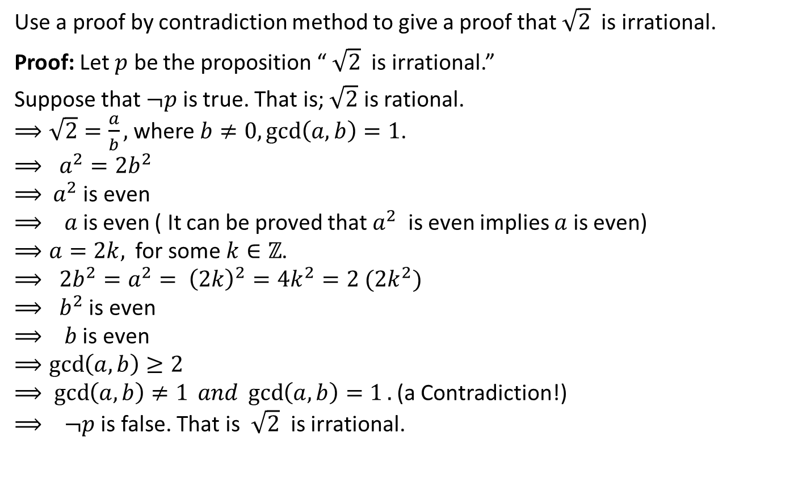
Proof by Contradiction – Example -1
Use a proof by contradiction method to give a proof that $\sqrt{2}$ is irrational.
Proof: Let $p$ be the proposition “ $\sqrt{2}$ is irrational.”
Suppose that $¬p$ is true. That is; $\sqrt{2}$ is rational.
$⟹\sqrt{2}=\frac{a}{b},$ where $b≠0, \gcd\left(a,b\right)=1$.
$⟹ a^{2}=2b^{2}$
$⟹$ $a^{2}$ is even
$⟹ a$is even ( It can be proved that $a^{2}$ is even implies $a$ is even)
$⟹a=2k,$ for some $k∈ℤ$.
$⟹ 2b^{2}=a^{2}= {\left(2k\right)}^{2}=4k^{2}=2 (2k^{2})$
$⟹ b^{2}$ is even
$⟹ b$ is even
$⟹\gcd\left(a,b\right)≥2$
$⟹ \gcd\left(a,b\right)≠1 and \gcd\left(a,b\right)=1.$(a Contradiction!)
$⟹ ¬p$ is false. That is $\sqrt{2}$ is irrational.

Slide 20
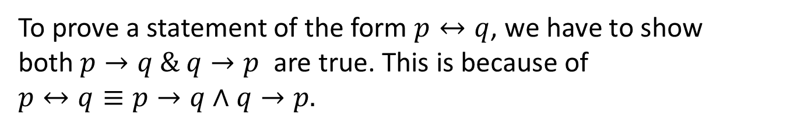

Proofs of Equivalence
Some of the Mathematical theorems are bi-conditional statements $p↔q.$
To prove a statement of the form $p↔q$, we have to show both$p→q \& q→p$ are true. This is because of $p↔q≡p→q∧q→p.$
Example: Prove the theorem “If n is an integer, then n is odd if and only if n² is odd.”

Slide 21
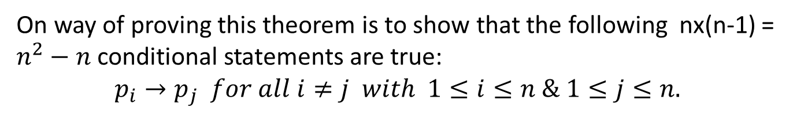
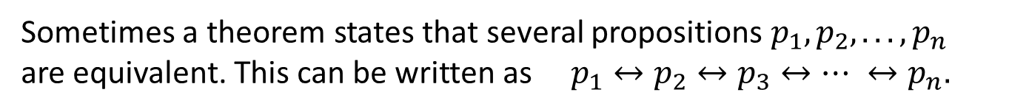
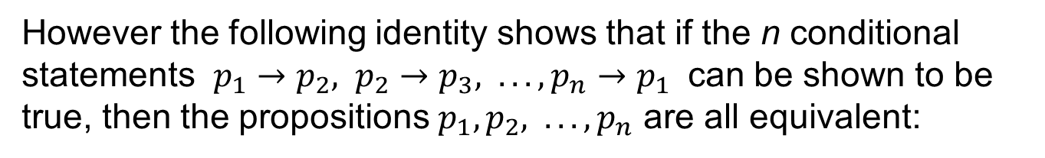
Proofs of Equivalence
Sometimes a theorem states that several propositions $p_{1}, p_{2}, . . . , p_{n}$ are equivalent. This can be written as $p_{1}↔p_{2}↔p_{3}↔⋯ ↔p_{n}.$
On way of proving this theorem is to show that the following nx(n-1) = $n^{2}−n$ conditional statements are true:
$$p_{i}→p_{j} for all i≠j with 1≤i≤n \& 1≤j≤n.$$
However the following identity shows that if the n conditional statements $p_{1}→p_{2}, p_{2}→p_{3}, . . . , p_{n}→p_{1}$ can be shown to be true, then the propositions $p_{1}, p_{2}, . . . , p_{n}$ are all equivalent:
$$p_{1}↔p_{2}↔p_{3}↔⋯ ↔p_{n}≡\left(p_{1}→p_{2}\right)⋀\left(p_{2}→p_{3}\right)⋀⋯⋀\left(p_{n}→p_{1}\right)$$

Slide 22
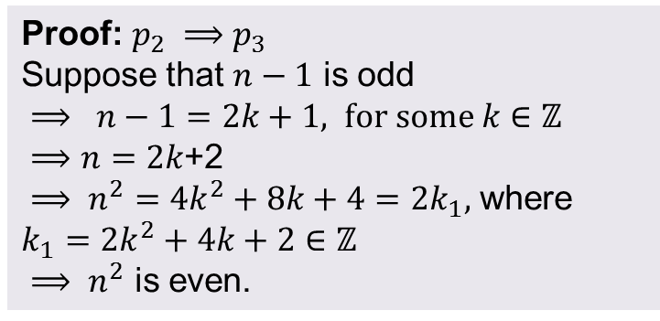
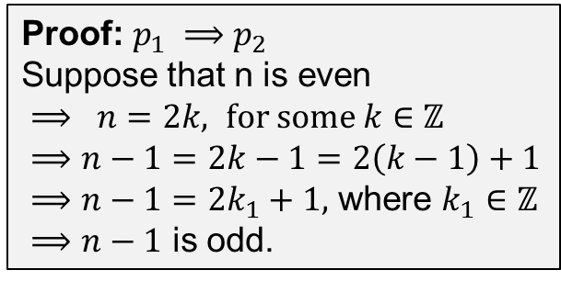

Example
Show that these statements about the integer n are equivalent:
p₁: n is even.
p₂: n−1 is odd.
p₃: n² is even.
Proof: $p_{2} ⟹p_{3}$
Suppose that $n−1$ is odd
$⟹ n−1=2k+1, for some k∈ℤ$
$⟹n=2k$+2
$⟹ n^{2}=4k^{2}+8k+4=2k_{1},$ where $k_{1}=2k^{2}+4k+2∈ℤ$
$⟹ n^{2}$ is even.
Proof: $p_{1} ⟹p_{2}$
Suppose that n is even
$⟹ n=2k, for some k∈ℤ$
$⟹n−1=2k−1=2\left(k−1\right)+1$
$⟹n−1=2k_{1}+1,$ where $k_{1}∈ℤ$
$⟹n−1$ is odd.
Proof: $p_{3} ⟹p_{1}≡¬p_{1}⟹¬p_{3}$
Suppose that $n$ is odd
$⟹ n=2k+1, for some k∈ℤ$
$⟹ n^{2}={\left(2k+1\right)}^{2}=4k^{2}+4k+1$
$⟹ n^{2}=2\left(2k^{2}+2k\right)+1$
$⟹ n^{2}=2k_{1}+1,$ where $k_{1}=2k^{2}+2k∈ℤ$
$⟹ n^{2}$ is odd

Slide 23
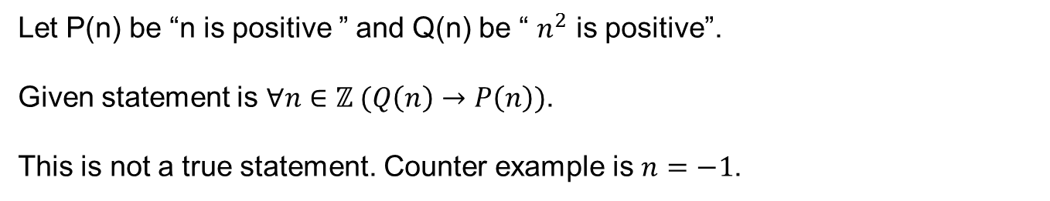

Counter Example
Prove or disprove the following statement.
For any integer $n$, If $n^{2}$ is positive, then $n$ is positive.
Let P(n) be “n is positive ” and Q(n) be “ $n^{2}$ is positive”.
Given statement is $∀n∈ℤ (Q\left(n\right)→P\left(n\right))$.
This is not a true statement. Counter example is $n=−1$.

Slide 24
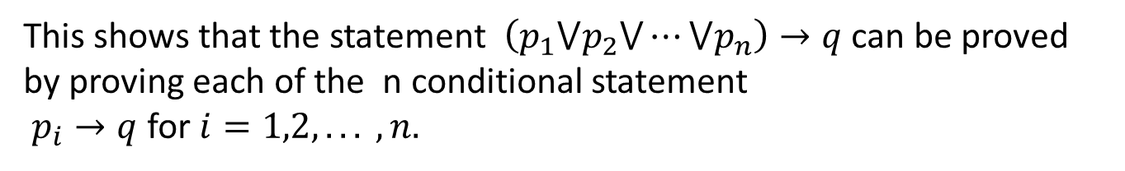
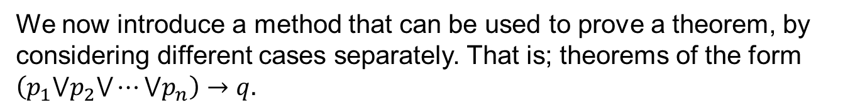

Exhaustive Proof and Proof by Cases
We now introduce a method that can be used to prove a theorem, by considering different cases separately. That is; theorems of the form $\left(p_{1}⋁p_{2}⋁⋯⋁p_{n}\right)→q.$
$\left(p_{1}⋁p_{2}⋁⋯⋁p_{n}\right)→q≡¬\left(p_{1}⋁p_{2}⋁⋯⋁p_{n}\right)⋁q$
$≡\left(¬p_{1}⋀¬p_{2}⋀⋯⋀¬p_{n}\right)$ $⋁q$
$$≡\left(¬p_{1}⋁q\right)⋀\left(¬p_{2}⋁q\right)⋀⋯⋀\left(¬p_{n}⋁q\right)$$
$≡\left(p_{1}→q\right)$ $⋀\left(p_{2}→q\right)⋀⋯⋀\left(p_{n}→q\right)$
This shows that the statement $\left(p_{1}⋁p_{2}⋁⋯⋁p_{n}\right)→q$ can be proved by proving each of the n conditional statement
$p_{i}→q$ for $i=1,2, . . . , n.$

Slide 25
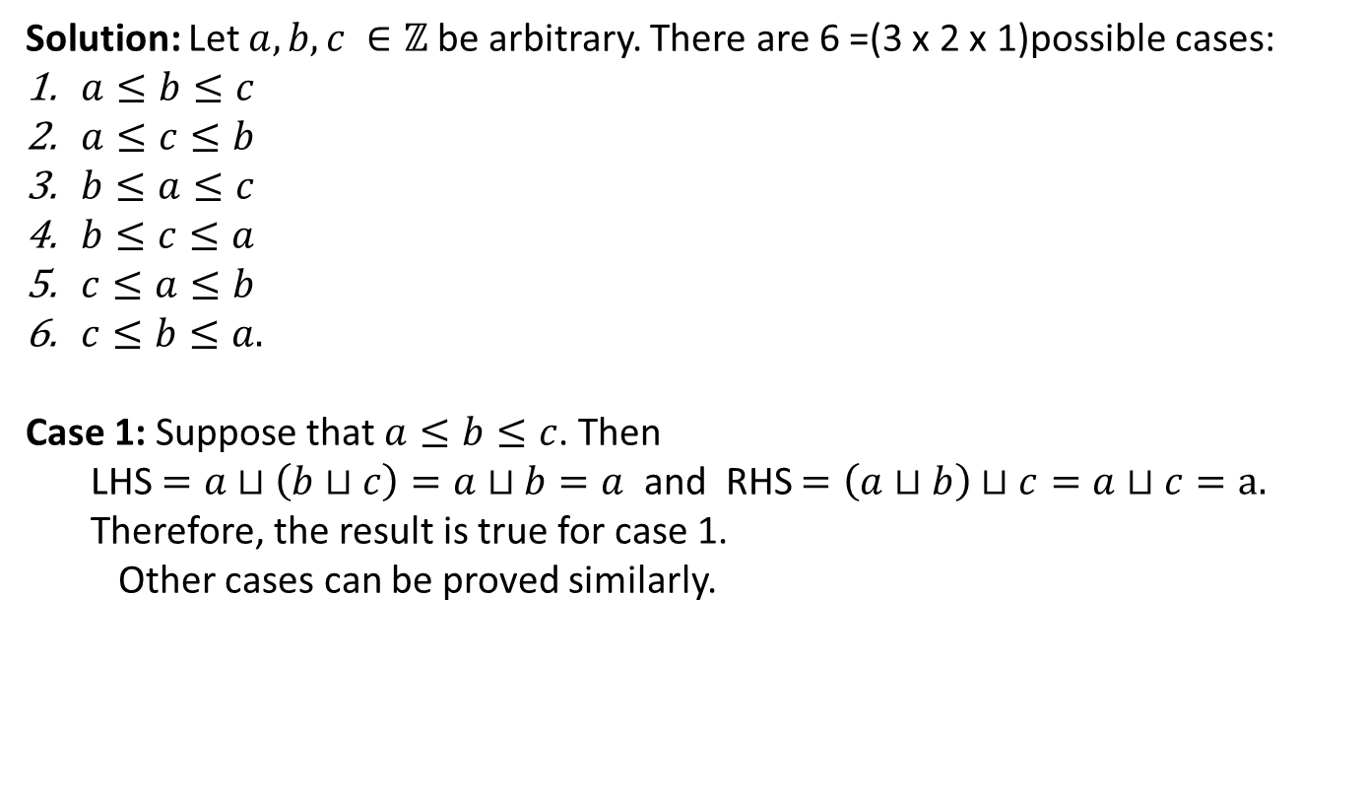

Proof by Cases – Example -1
Let $⊔$ be an operator defined by $⊔\left(a,b\right)=Min\left(a,b\right) ∀ a, b∈ℤ.$
Show that
$a⊔\left(b⊔c\right)=\left(a⊔b\right)⊔c for all a,b,c ∈ℤ$.
Solution: Let $a,b,c ∈ℤ$ be arbitrary. There are 6 =(3 x 2 x 1)possible cases:
$a≤b≤c$
$a≤c≤b$
$b≤a≤c$
$b≤c≤a$
$c≤a≤b$
$c≤b≤a.$
Case 1: Suppose that $a≤b≤c$. Then
LHS $=a⊔\left(b⊔c\right)=a⊔b=a$ and RHS $=\left(a⊔b\right)⊔c=a⊔c=a.$
Therefore, the result is true for case 1.
Other cases can be proved similarly.

Slide 26
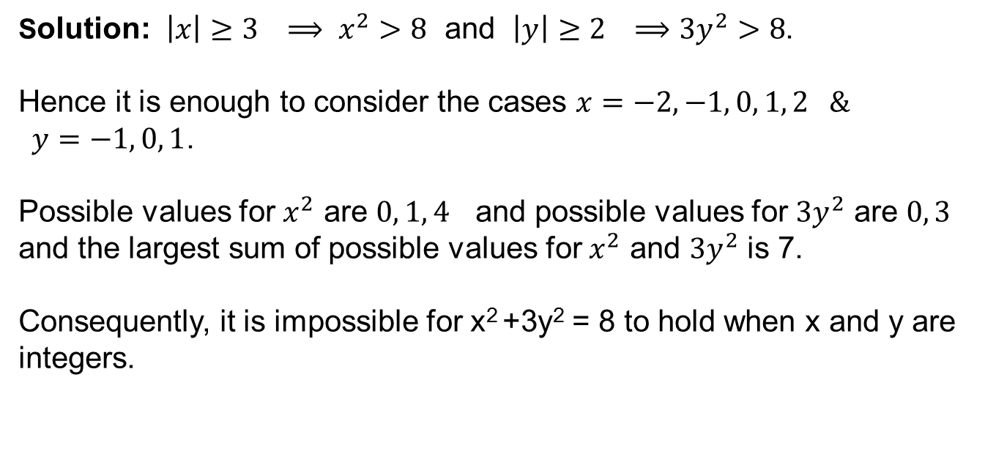
Proof by Cases – Example - 2
Show that there are no solutions in integers x and y of x² +3y² = 8.
Solution: $\left|x\right|≥3 ⟹ x^{2}>8$ and $\left|y\right|≥2 ⟹3y^{2}>8$.
Hence it is enough to consider the cases $x=−2, −1, 0, 1, 2 \&$
$y=−1, 0, 1$.
Possible values for $x^{2}$ are $0, 1, 4$ and possible values for $3y^{2}$ are $0, 3$ and the largest sum of possible values for $x^{2}$ and $3y^{2}$ is 7.
Consequently, it is impossible for x² +3y² = 8 to hold when x and y are integers.

Slide 27
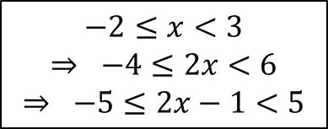
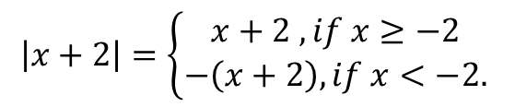
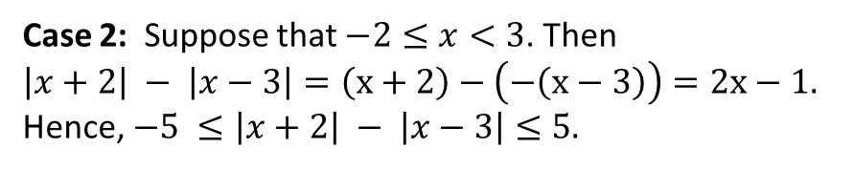

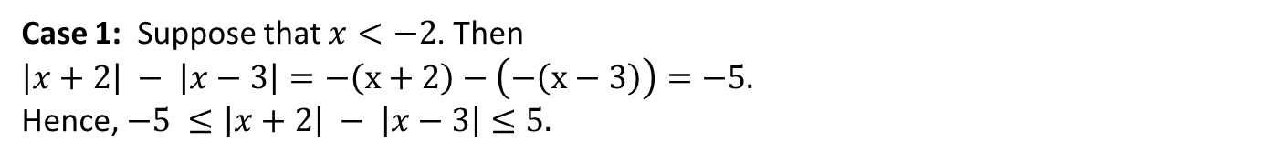
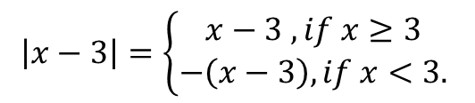
Proof by Cases – Example - 3
Prove that for all $x∈ℝ$ , $−5 ≤\left|x+2\right| − \left|x−3\right|≤5.$
Proof:
$$\left|x+2\right|=\left\{\begin{aligned}x+2 , if x≥−2 \\ −\left(x+2\right), if x<−2.\end{aligned}\right.$$
$$\left|x−3\right|=\left\{\begin{aligned}x−3 , if x≥3 \\ −\left(x−3\right), if x<3.\end{aligned}\right.$$
Given the way the functions are broken apart, we shall consider the cases
$$x<−2, −2≤x<3, x≥3.$$
Case 1: Suppose that $x<−2$. Then
$\left|x+2\right| − \left|x−3\right|=−\left(x+2\right)−\left(−\left(x−3\right)\right)=−5.$
Hence, $−5 ≤\left|x+2\right| − \left|x−3\right|≤5.$
Case 2: Suppose that $−2≤x<3$. Then
$\left|x+2\right| − \left|x−3\right|=\left(x+2\right)−\left(−\left(x−3\right)\right)=2x−1.$
Hence, $−5 ≤\left|x+2\right| − \left|x−3\right|≤5.$
$$−2≤x<3$$
$$⇒ −4≤2x<6$$
$$⇒ −5≤2x−1<5$$

Slide 28
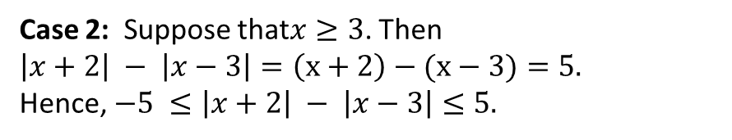
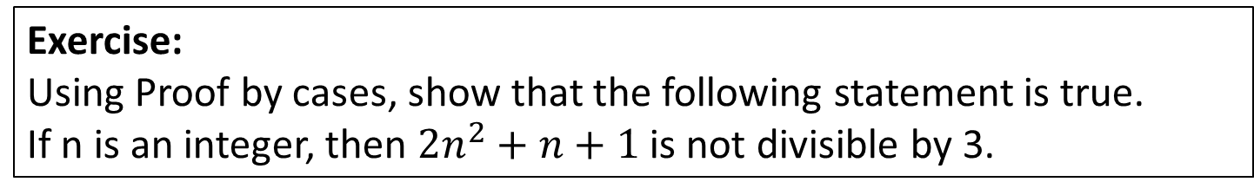
Example – 3 Cont.
Case 2: Suppose that$x≥3$. Then
$\left|x+2\right| − \left|x−3\right|=\left(x+2\right)−(x−3)=5.$
Hence, $−5 ≤\left|x+2\right| − \left|x−3\right|≤5.$
Since $−5 ≤\left|x+2\right| − \left|x−3\right|≤5$ holds all three cases, we have
$$−5 ≤\left|x+2\right| − \left|x−3\right|≤5, ∀x∈ℝ.$$
Exercise:
Using Proof by cases, show that the following statement is true.
If n is an integer, then $2n^{2}+n+1$ is not divisible by 3.

Slide 29
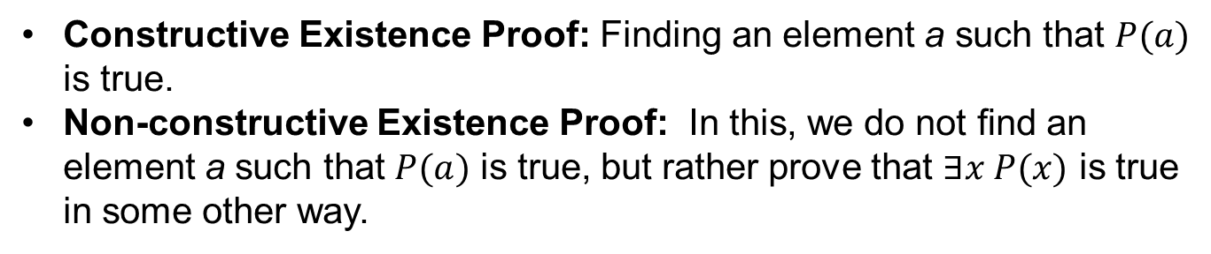
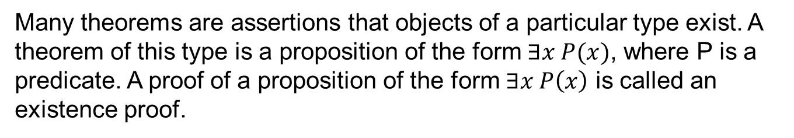
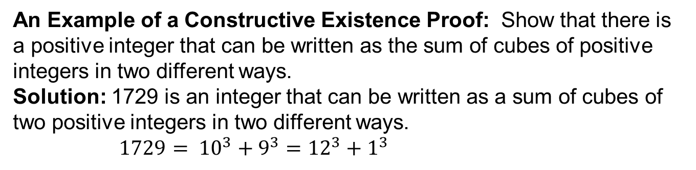
Existence Proofs
Many theorems are assertions that objects of a particular type exist. A theorem of this type is a proposition of the form $∃x P(x)$, where P is a predicate. A proof of a proposition of the form $∃x P\left(x\right)$ is called an existence proof.
Constructive Existence Proof: Finding an element a such that $P(a)$ is true.
Non-constructive Existence Proof: In this, we do not ﬁnd an element a such that $P(a)$ is true, but rather prove that $∃x P(x)$ is true in some other way.
An Example of a Constructive Existence Proof: Show that there is a positive integer that can be written as the sum of cubes of positive integers in two different ways.
Solution: 1729 is an integer that can be written as a sum of cubes of two positive integers in two different ways.
$1729= {10}^{3}+9^{3}={12}^{3}+1^{3}$

Slide 30
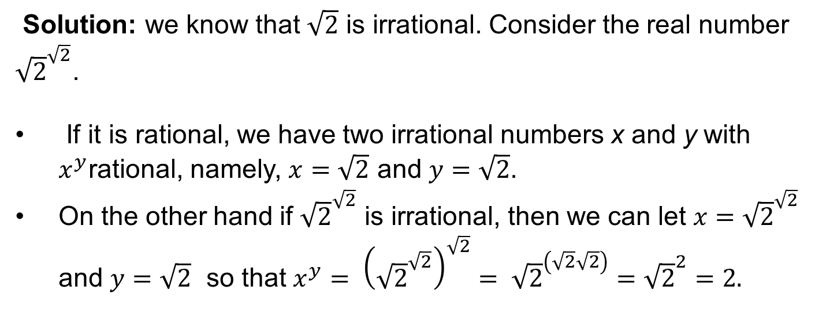
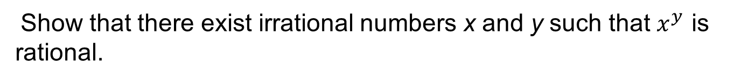
An Example of a Non-constructive Existence Proof
Show that there exist irrational numbers x and y such that $x^{y}$ is rational.
Solution: we know that $\sqrt{2}$ is irrational. Consider the real number ${\sqrt{2}}^{\sqrt{2}}$.
If it is rational, we have two irrational numbers x and y with $x^{y}$rational, namely, $x=\sqrt{2}$ and $y=\sqrt{2}$.
On the other hand if ${\sqrt{2}}^{\sqrt{2}}$ is irrational, then we can let $x={\sqrt{2}}^{\sqrt{2}}$ and $y=\sqrt{2}$ so that $x^{y}= {\left({\sqrt{2}}^{\sqrt{2}}\right)}^{\sqrt{2}}= {\sqrt{2}}^{\left(\sqrt{2}\sqrt{2}\right)}={\sqrt{2}}^{2}=2.$

Slide 31
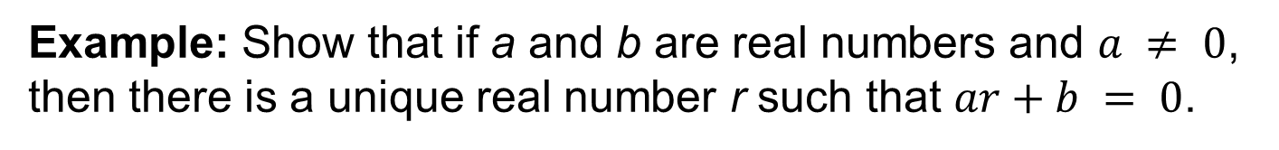
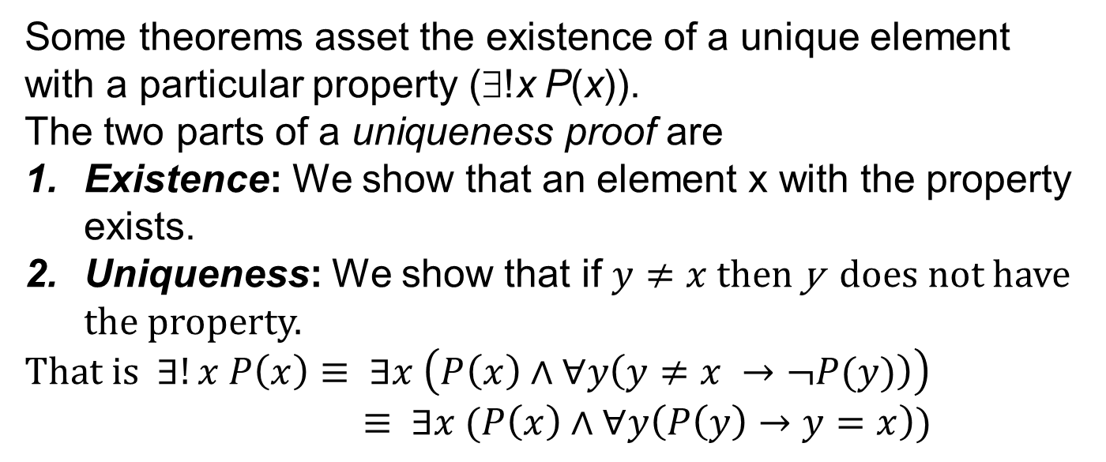
Uniqueness Proofs
Some theorems asset the existence of a unique element with a particular property (∃!x P(x)).
The two parts of a uniqueness proof are
Existence: We show that an element x with the property exists.
Uniqueness: We show that if $y≠x$then y does not have the property.
That is $∃!x P\left(x\right)≡ ∃x \left(P\left(x\right)∧∀y\left(y≠x →¬P(y)\right)\right)$
$≡ ∃x (P\left(x\right)∧∀y\left(P\left(y\right)→y=x\right))$
Example: Show that if a and b are real numbers and $a ≠ 0$, then there is a unique real number r such that $ar+b = 0$.

Slide 32
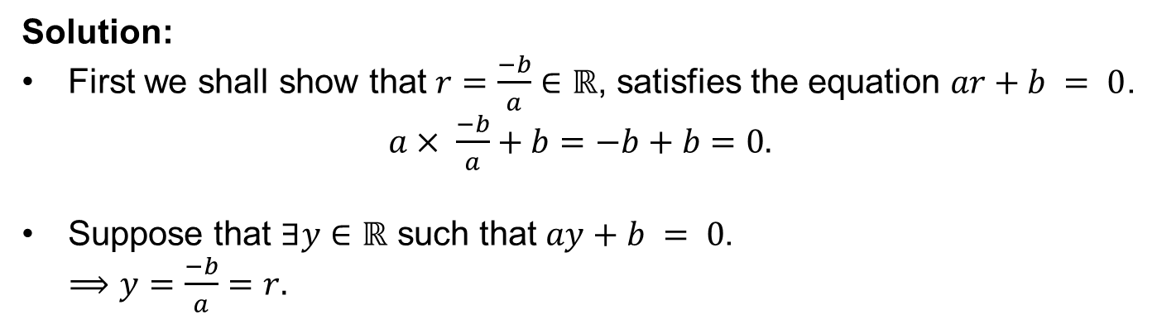
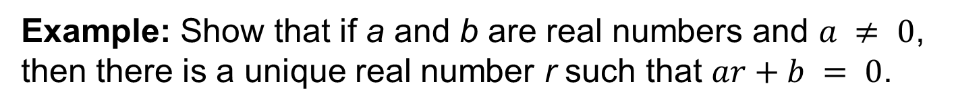
Example
Example: Show that if a and b are real numbers and $a ≠ 0$, then there is a unique real number r such that $ar+b = 0$.
Solution:
First we shall show that $r=\frac{−b}{a}∈ℝ$, satisfies the equation $ar+b = 0$.
$a× \frac{−b}{a}+b=−b+b=0.$
Suppose that $∃y∈ℝ$ such that $ay+b = 0$.
$⟹y=\frac{−b}{a}=r.$

Slide 33
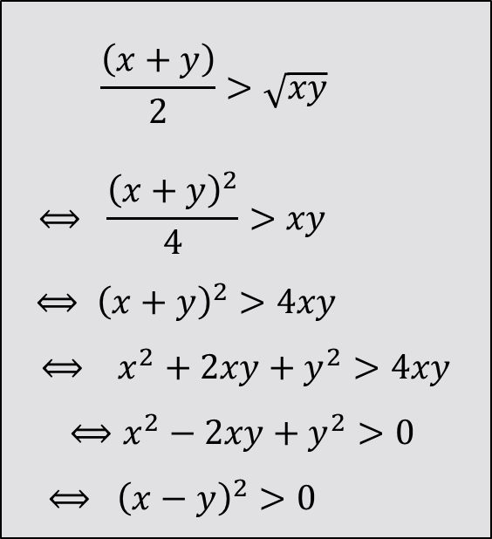
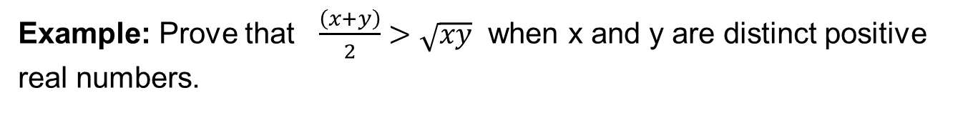
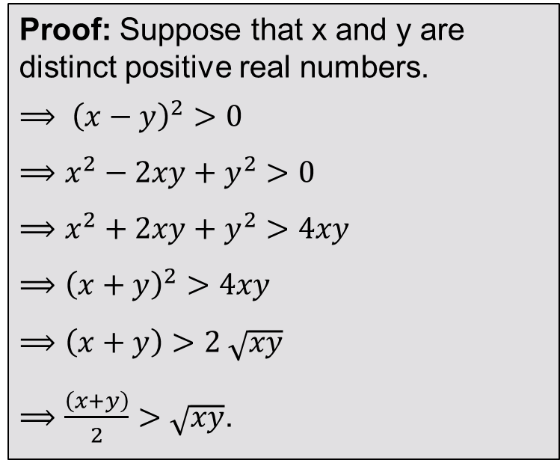
Backward Reasoning
Example: Prove that $\frac{\left(x+y\right)}{2}>\sqrt{xy}$ when x and y are distinct positive real numbers.
$$\frac{\left(x+y\right)}{2}>\sqrt{xy}$$
$$⟺ \frac{{\left(x+y\right)}^{2}}{4}>xy$$
$$⟺ {\left(x+y\right)}^{2}>4xy$$
$$⟺ x^{2}+2xy+y^{2}>4xy$$
$⟺x^{2}−2xy+y^{2}>0$
$$⟺ {\left(x−y\right)}^{2}>0$$
Proof: Suppose that x and y are distinct positive real numbers.
$⟹ {\left(x−y\right)}^{2}>0$
$⟹x^{2}−2xy+y^{2}>0$
$⟹x^{2}+2xy+y^{2}>4xy$
$⟹{\left(x+y\right)}^{2}>4xy$
$⟹\left(x+y\right)>2 \sqrt{xy}$
$⟹\frac{\left(x+y\right)}{2}>\sqrt{xy}$.

Slide 34
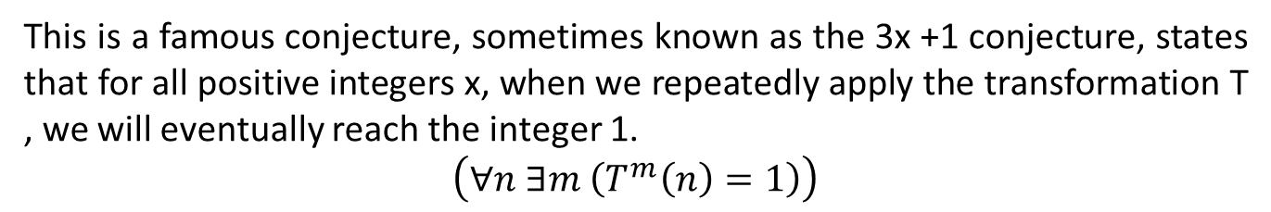
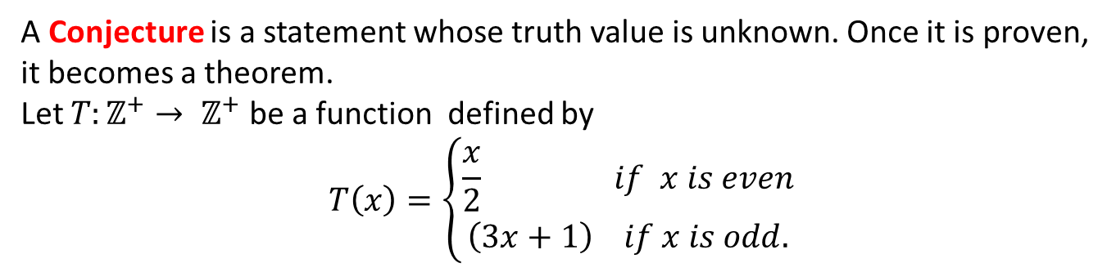
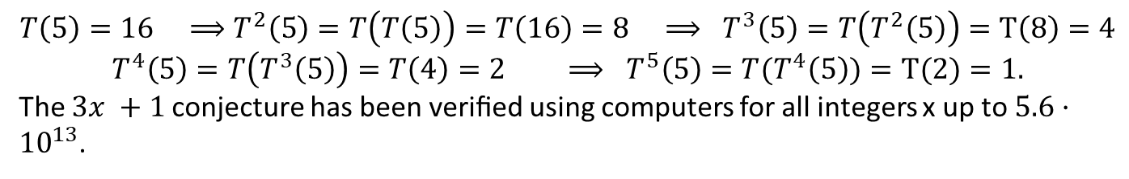
The 3x +1 Conjecture
A Conjecture is a statement whose truth value is unknown. Once it is proven, it becomes a theorem.
Let $T:ℤ^{+}→ ℤ^{+}$ be a function defined by
$$T\left(x\right)=\left\{\begin{aligned}\frac{x}{2} if x is even \\ \left(3x+1\right) if x is odd.\end{aligned}\right.$$
This is a famous conjecture, sometimes known as the 3x +1 conjecture, states that for all positive integers x, when we repeatedly apply the transformation T , we will eventually reach the integer 1.
$$\left(∀n ∃m \left(T^{m}\left(n\right)=1\right)\right)$$
$$T\left(5\right)=16 ⟹T^{2}\left(5\right)=T\left(T\left(5\right)\right)=T\left(16\right)=8 ⟹ T^{3}\left(5\right)=T\left(T^{2}\left(5\right)\right)=T\left(8\right)=4$$
$$T^{4}\left(5\right)=T\left(T^{3}\left(5\right)\right)=T\left(4\right)=2 ⟹ T^{5}\left(5\right)=T{(T}^{4}\left(5\right))=T(2)=1.$$
The $3x +1$conjecture has been veriﬁed using computers for all integers x up to $5.6·{10}^{13}$.

